Slide 1
Science on Drupal Prototype 2.0

Slide 2
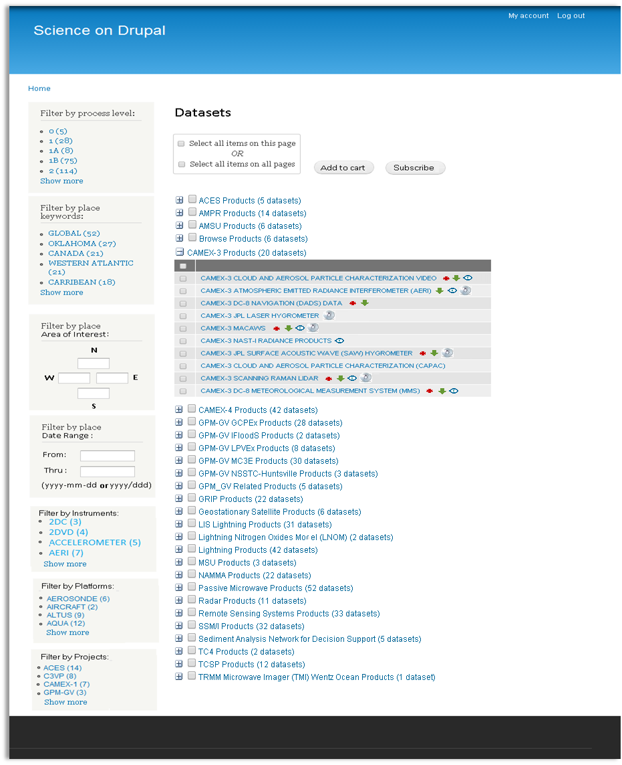
Entry Page : Faceted Search for Datasets
Users can either order data right away or create subscriptions to receive data at specified frequency
Collapsible groups
Admin can arrange these blocks

Slide 3
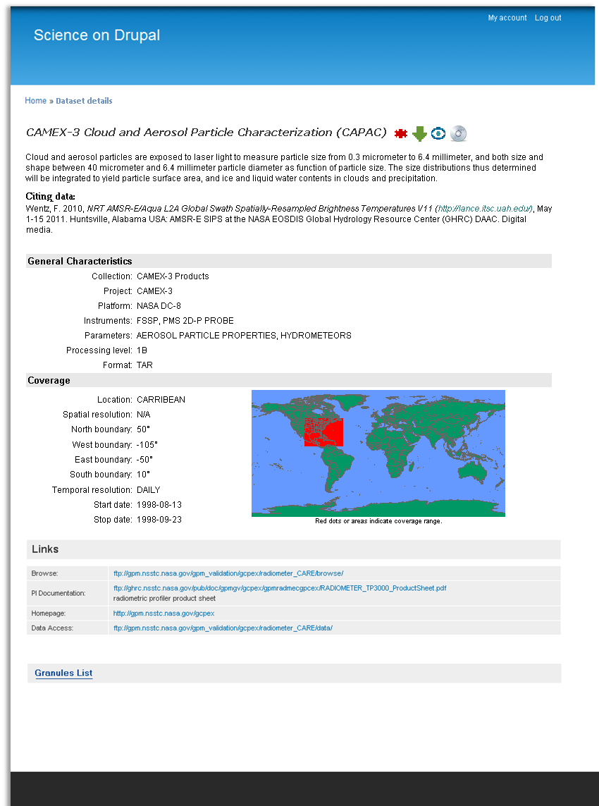
Dataset Details Page

Slide 4
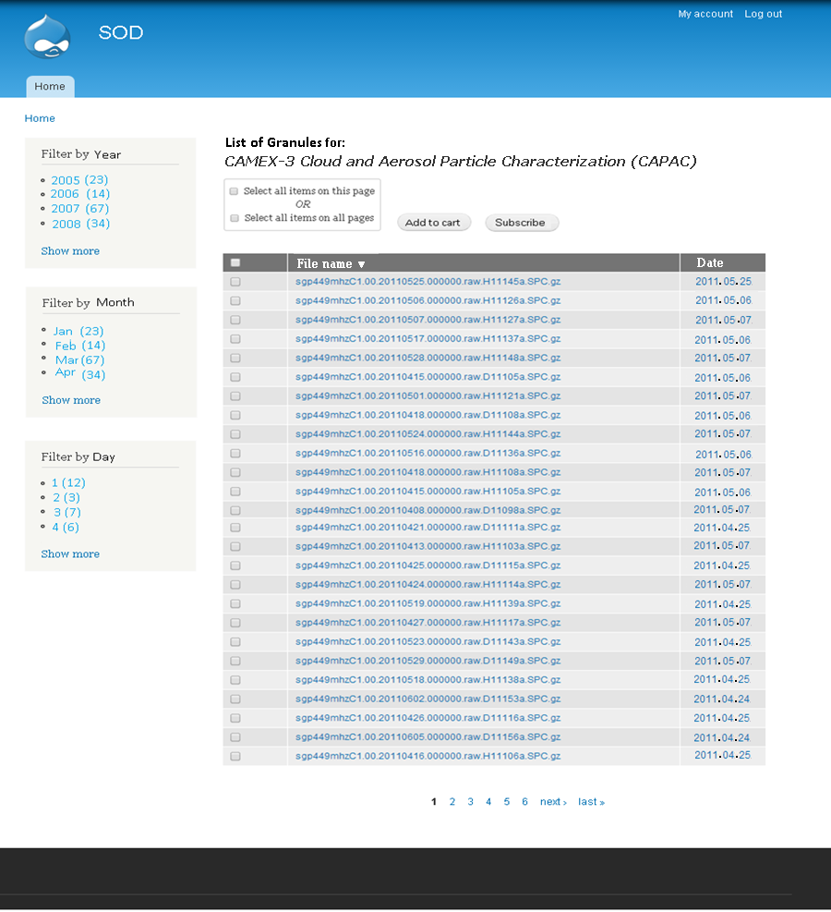
User’s Granules Listings Page

Slide 5
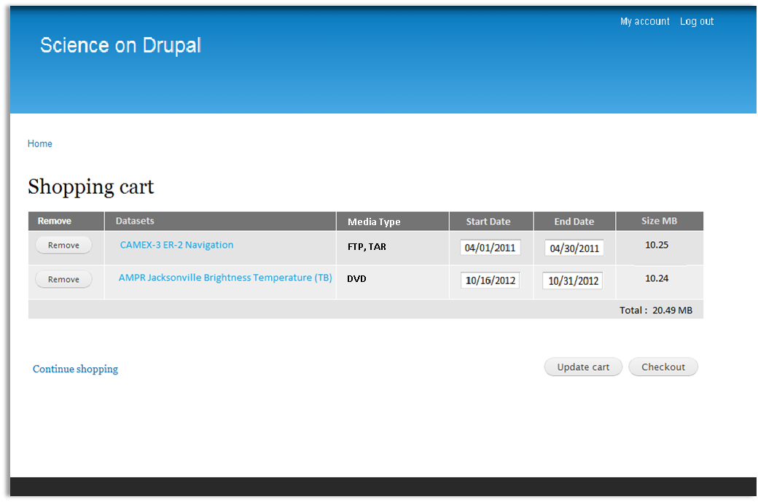
User’s Shopping cart page

Slide 6
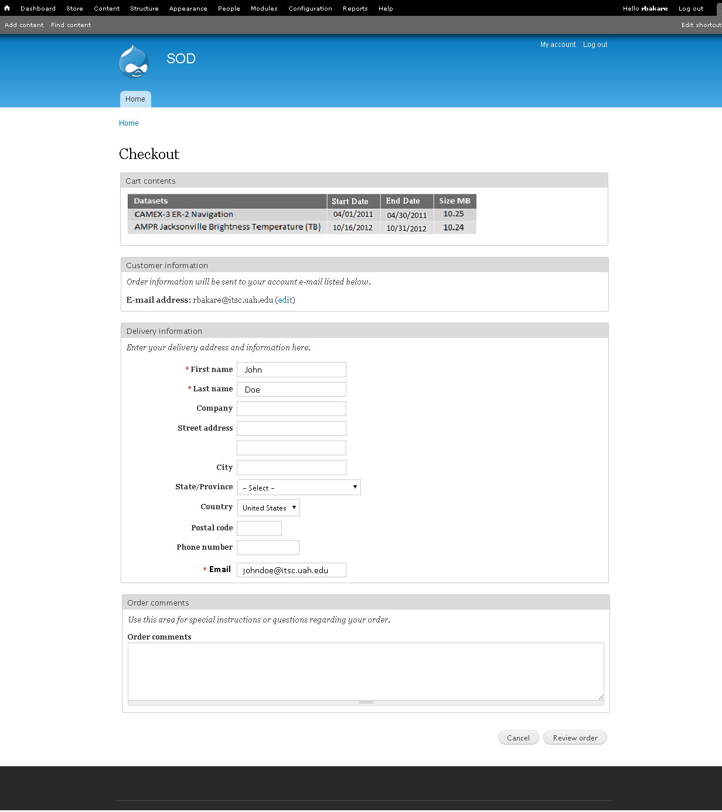
User Order Checkout page

Slide 7
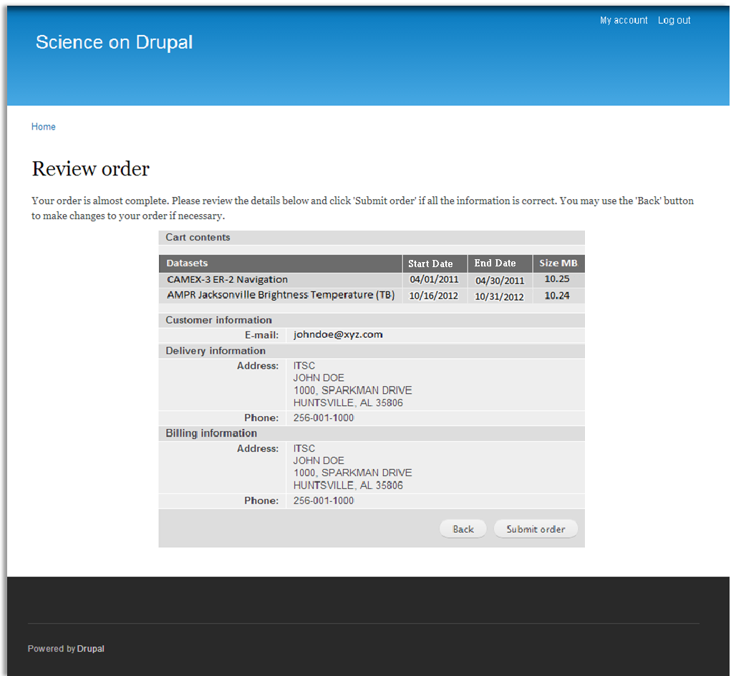
User’s Review Order page

Slide 8
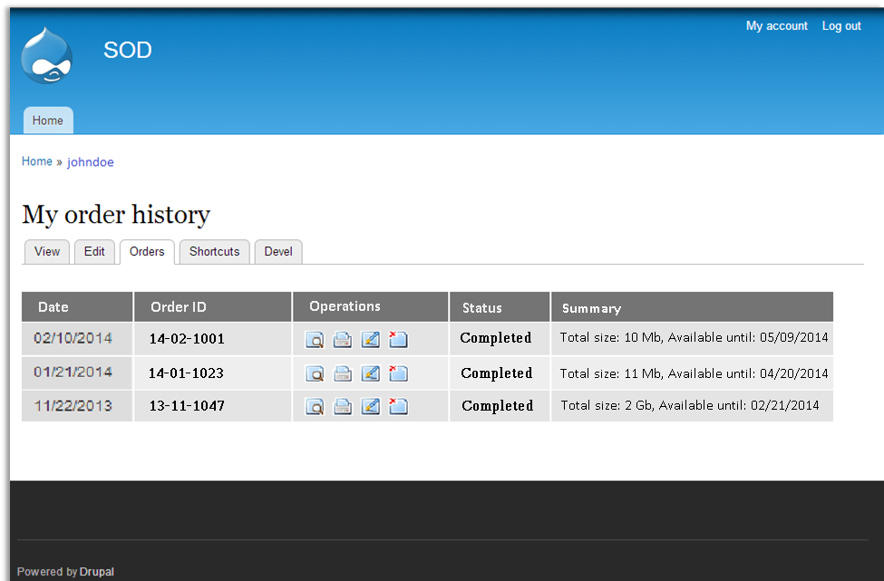
User’s Order History page

Slide 9
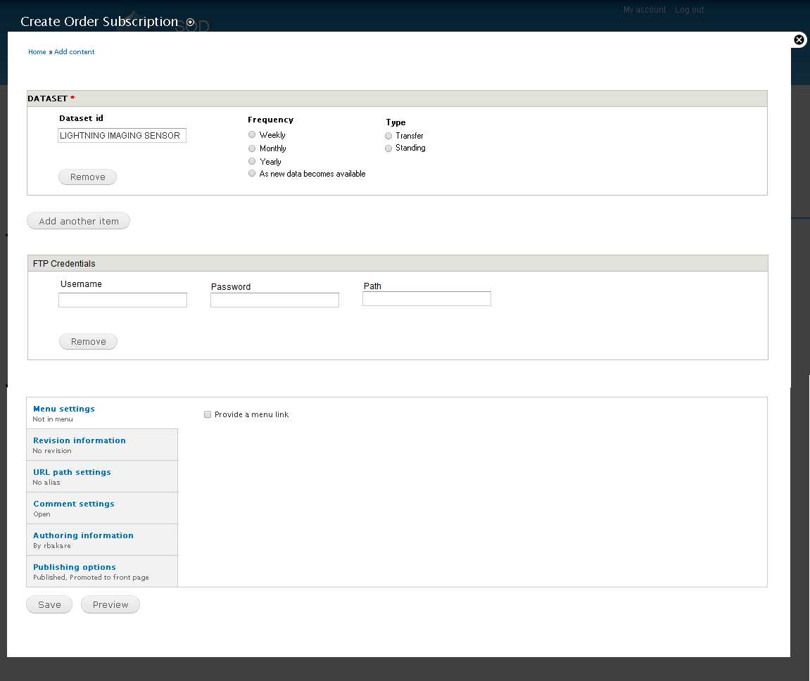
User’s Order Subscription Page

Slide 10
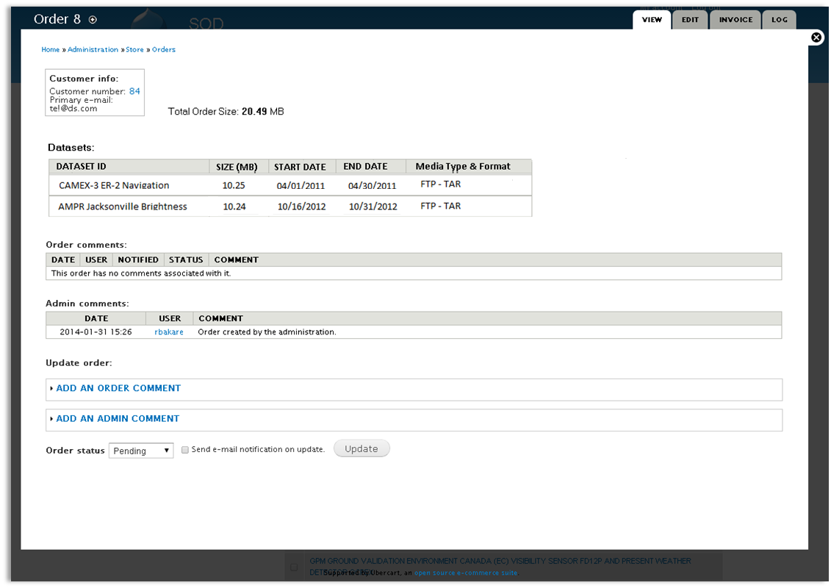
Admin’s View Order Page

Slide 11
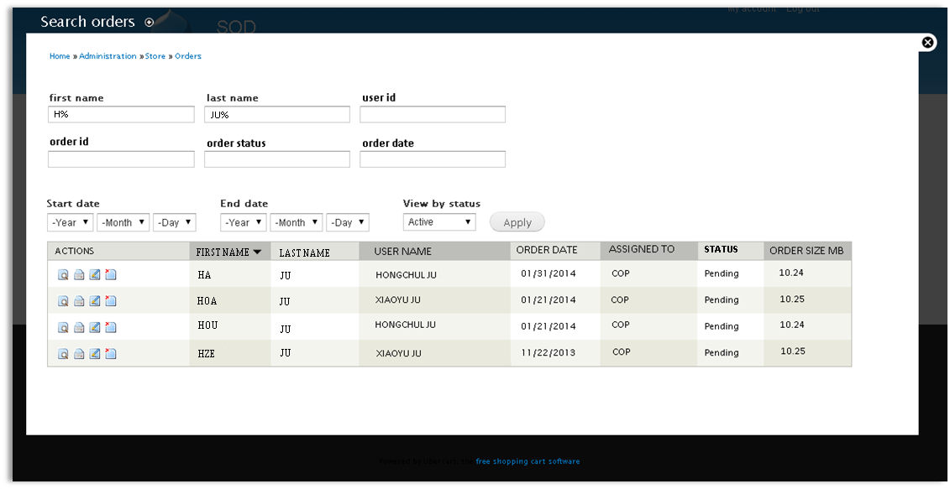
Admin’s Search Order Page

Slide 12
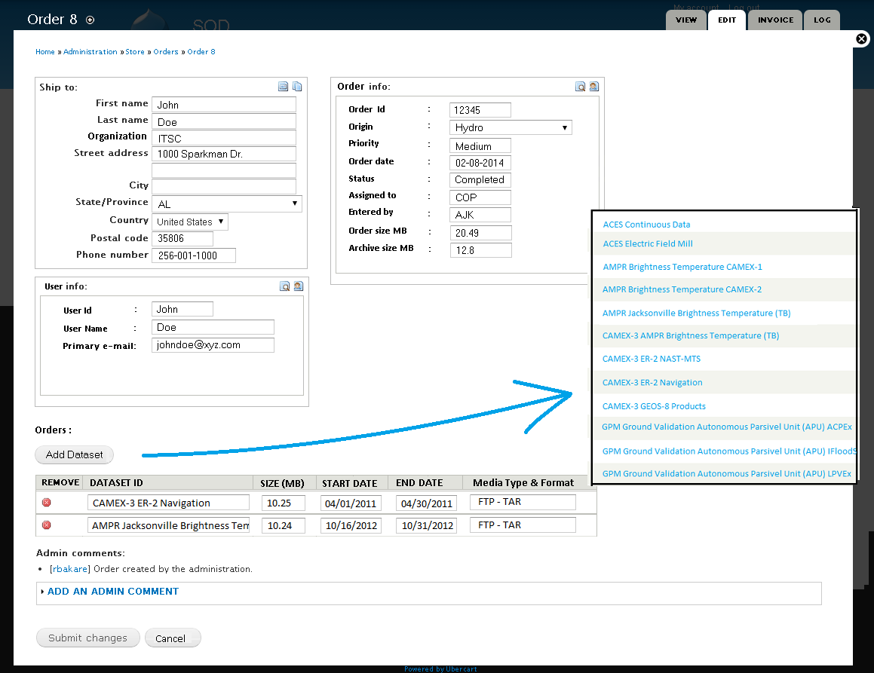
Admin’s Edit Order Page

Slide 13
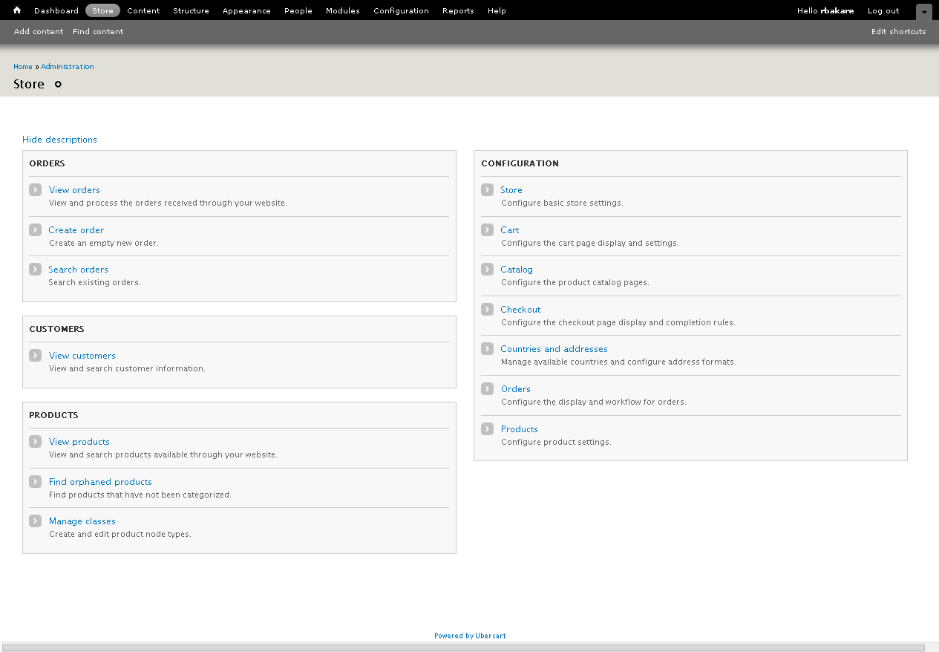
Admin Store page

Slide 14
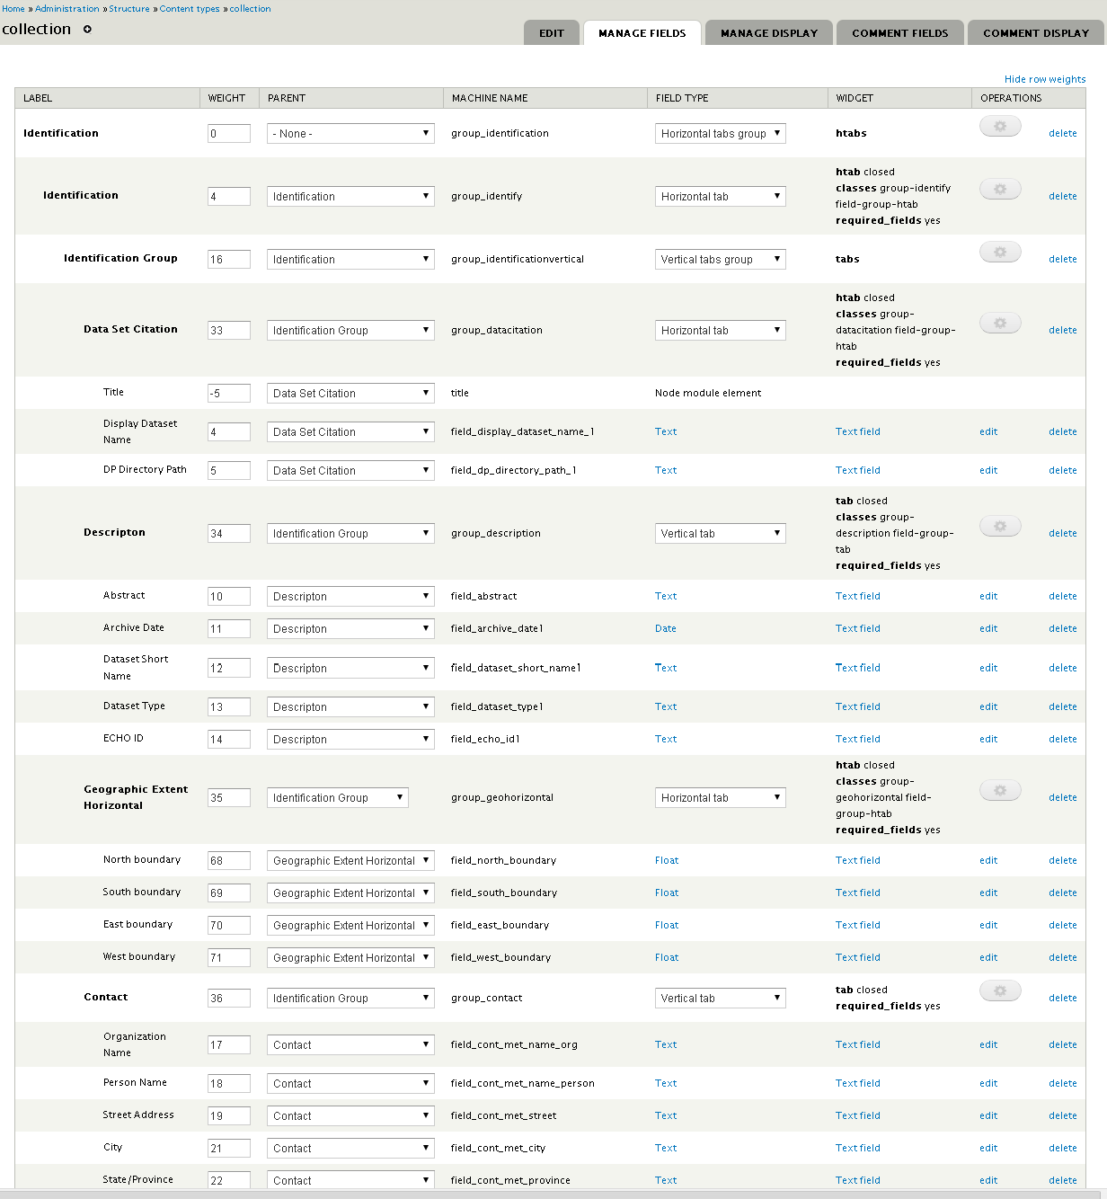
Admin Page: Content Type - Collection

Slide 15
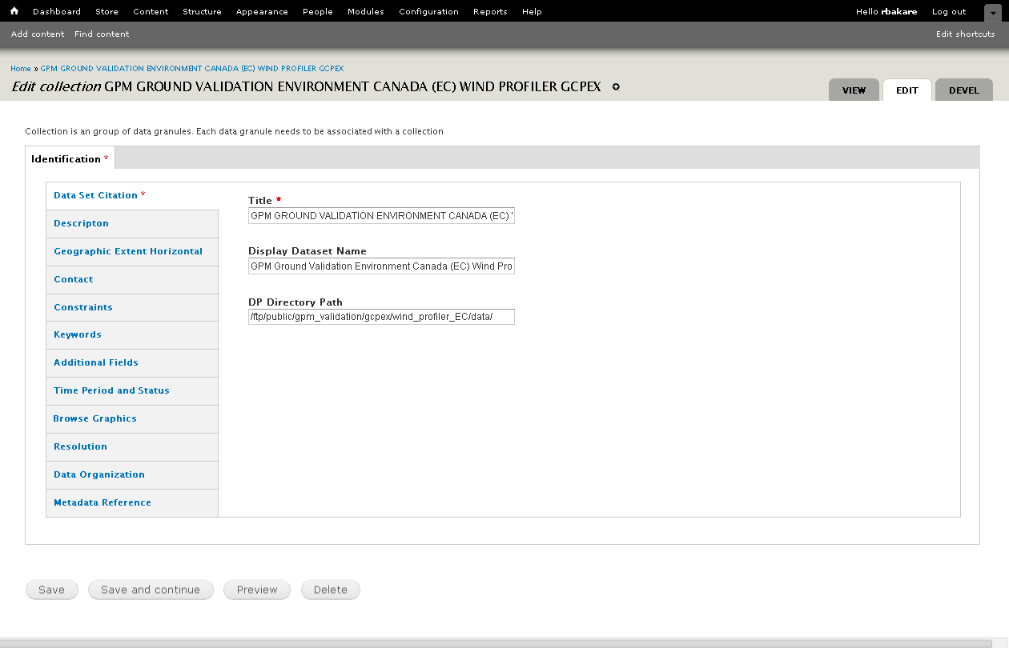
Edit Dataset page

